Slide 1

High-Dimensional Covariance Matrix Estimation
Undergraduate semester-long project
Hector Kohler
Examiners: Dr Saralees Nadarajah, Prof Jianxin Pan

Slide 2
What is High-Dimensional data ?
More features than observations
Usually seen in health data or time series
Not easy to get statistics from such data

Slide 3
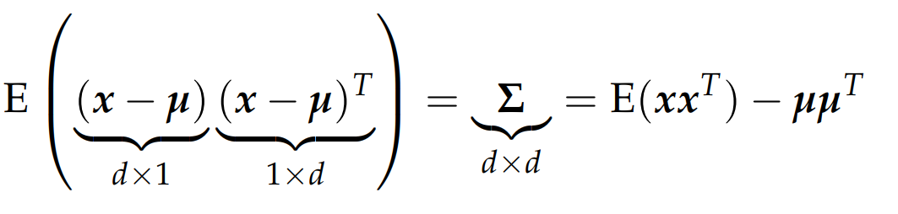
Covariance Matrix
Population form of the covariance matrix for a d-dimensional random vector:
Symmetric
Real entries greater or equal to zero
Positive semi-definite

Slide 4
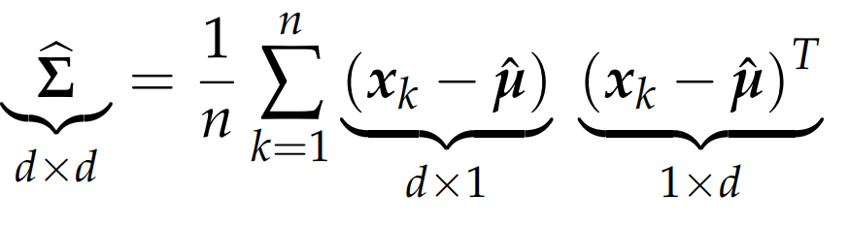
Covariance Matrix Estimation
The problem of covariance matrix estimation is to estimate a covariance matrix from a sample dataset such that the estimator has good properties (MLE, small MSE, Invertible, easy to compute….)
Sample form of the covariance matrix (estimator) for a dataset of n observations and d features (n>=d):

Slide 5
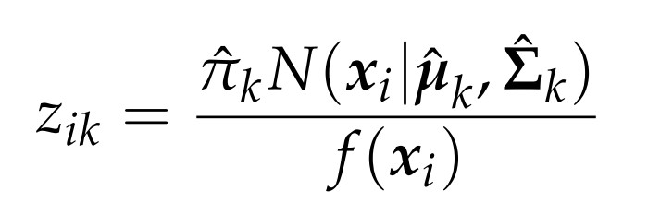
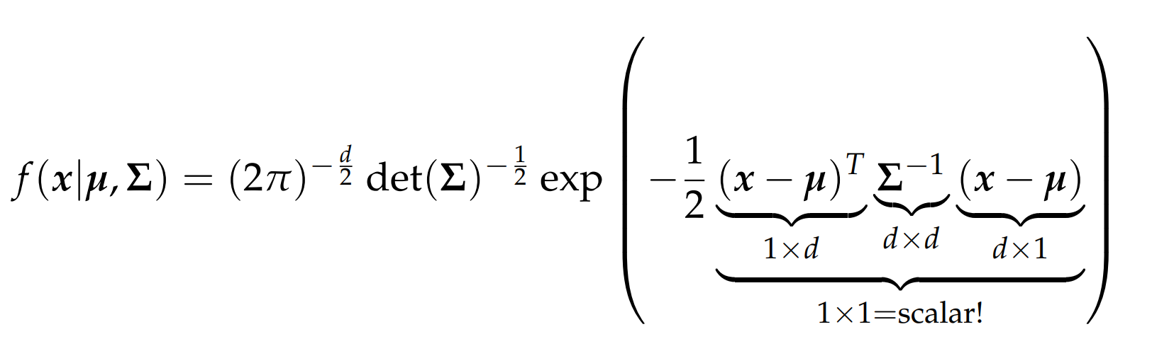
The sample covariance is the MLE of the covariance parameter in the density of a MVN. We compute the inverse of the sample covariance in many tasks for example in the expectation step of EM algorithm:
With the density of the MVN:

Slide 6
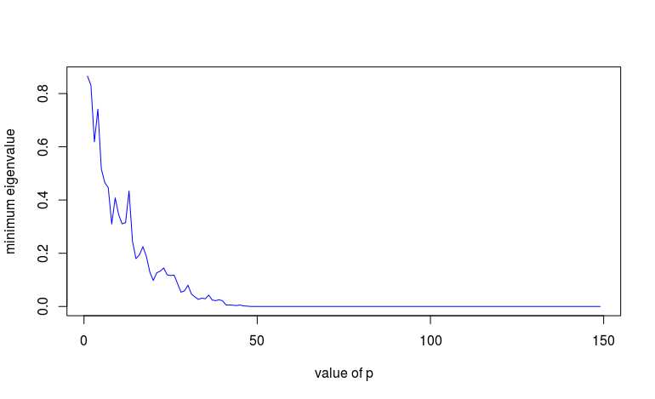
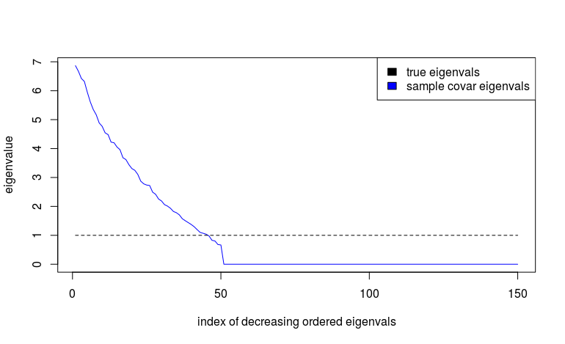
Is the sample covariance invertible ?
Not for high-dimensional datasets!
Value of the minimum eigenvalue of the sample covariance for a dataset with fixed n=50 generated from N(0,I)
Ordered eigenvalue of the sample covariance of 50 observations from N(0,I)

Slide 7

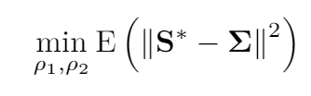






Ledoit-Wolf shrinkage estimator
The Ledoit-Wolf estimator is positive definite estimator of the form:
To find the coefficients we minimize the MSE with the real covariance matrix:
Under certain conditions, we find the sample form of the LW estimator:
With

Slide 8
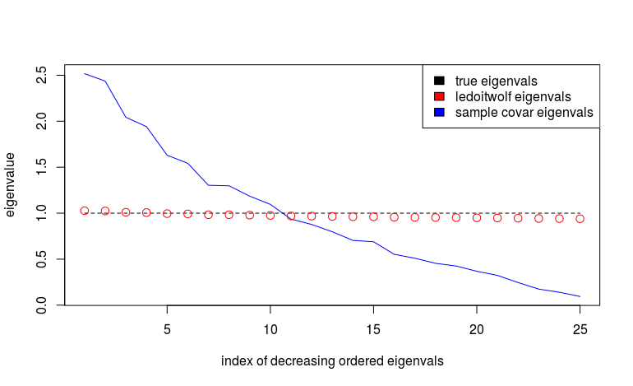
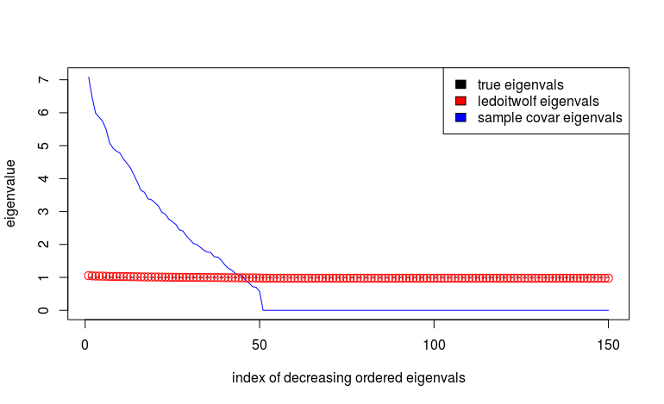
Eigenvalues of LW estimator
Ratio p/n = 0.5
Ratio p/n = 3 (high-dimensional)

Slide 9
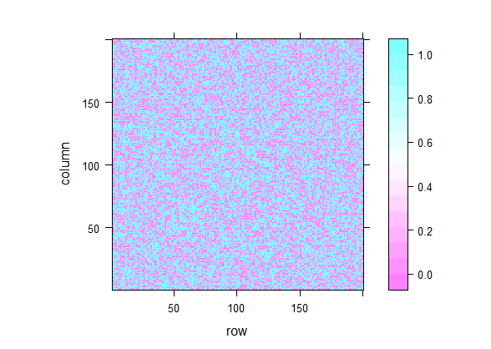
Limits to the LW estimator
Computationally expensive because the coefficients of the linear combination are estimated from the data
Do not necessarily preserve sparsity !
LW estimator of covariance of data generated from N(0,I) n=100, p=200

Slide 10
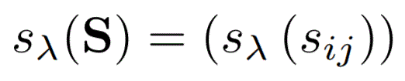


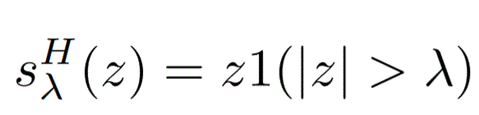
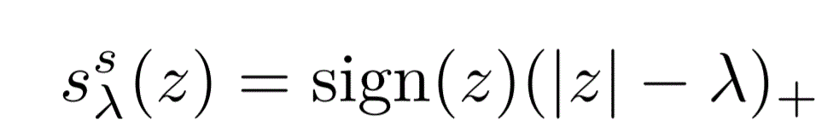
Thresholding Estimator
The thresholding estimator for a sample covariance matrix S is of the form:
With for some and for all :
(Hard)
(Soft)

Slide 11
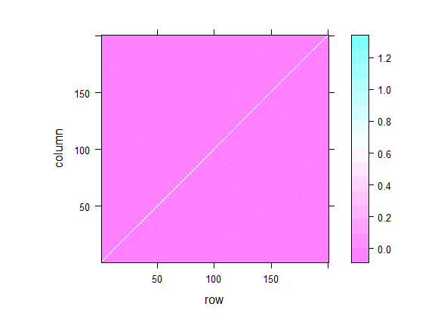
Hard and Soft Thresholding are easy to compute, preserve sparsity but not PD:
Hard Thresholding estimator of covariance of data generated from N(0,I) n=100, p=200
Soft Thresholding estimator of covariance of data generated from N(0,I) n=100, p=200

Slide 12
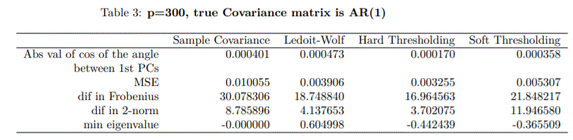
Conclusion and Discussion
Many covariance estimators with different advantages and properties.
Ongoing research topic.
A need for a framework to choose what kind of estimators:
Adapt some classical methods and their corresponding R (or other programming language) implementation.

Slide 13
References:
Olivier Ledoit and Michael Wolf. A well-conditioned estimator for large dimensional covariance matrices. Journal of Multivariate Analysis 88 p365–411, 2004.
Peter J. Bickel and Elizaveta Levina. Covariance Regularization By Thresholding. The Annals of Statistics, 2008
Yixin Fang, Binhuan Wang, Yang Feng Tuning Parameter Selection in Regularized Estimations of Large Covariance Matrices. Journal of Statistical Computation and Simulation, 2016

Slide 14
